Slide 1
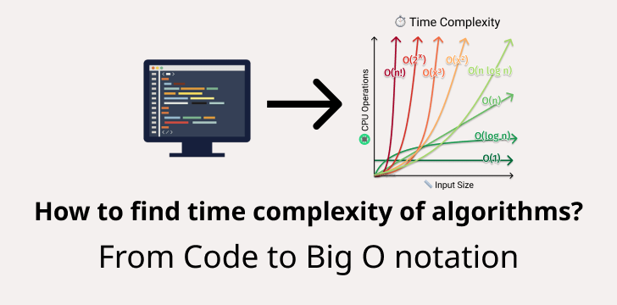
Big O notation and searching alghoritms

Slide 2
Big o notation cases
*Best
*avarage
* worst case
What is time complexity?

Slide 3
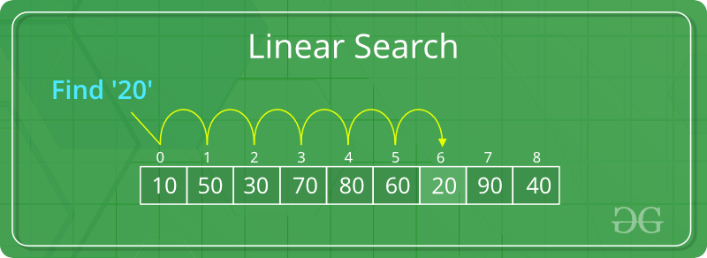
LINEAR SEARCH
Linear search is the simplest method for searching.
Sorted and unsorted

Slide 4
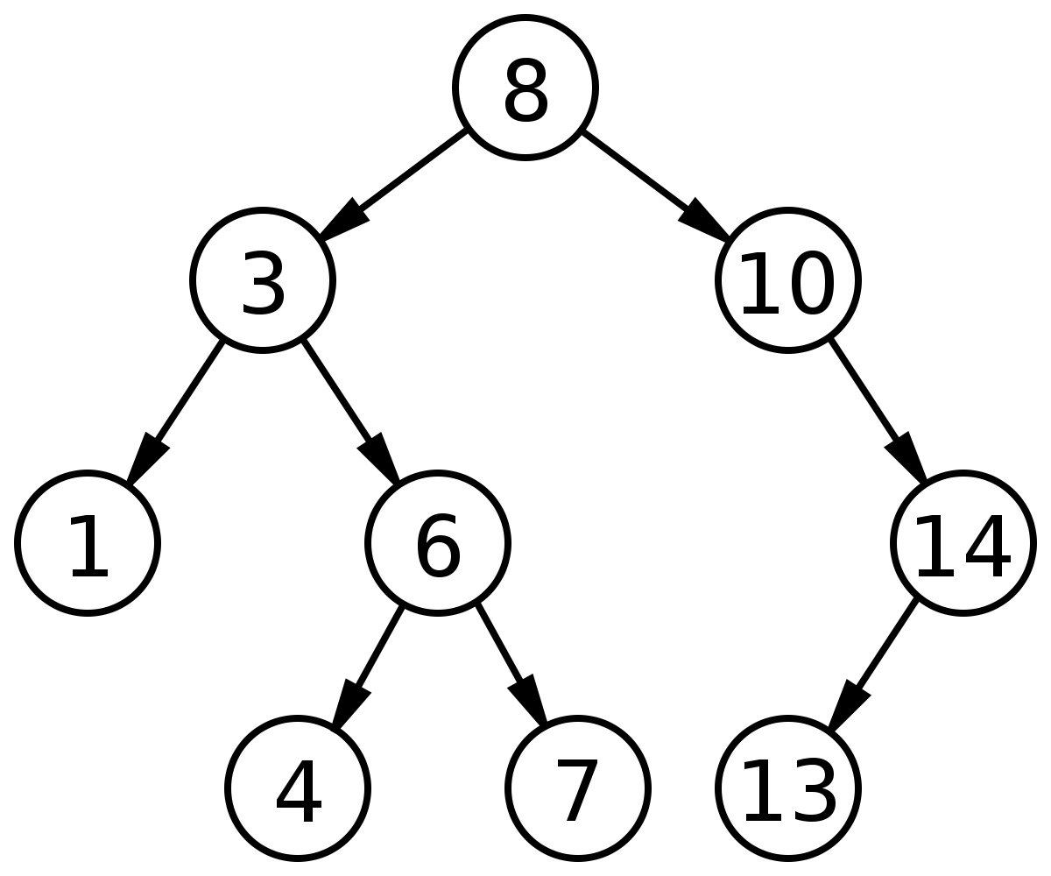
BINARY SEARCH
is an efficient algorithm for finding an item from a sorted list of items
Binary search tree:

Slide 5

JUMP SEARCH
divide the array into blocks of fixed size and then jump from one block to another

Slide 6
Interpolation Search
Works on sorted arrays
Its own unique alghoritm
https://www.youtube.com/watch?v=DlCPTPQD6Mw

Slide 7
Exponential Search
steps
Find range where element is present
Do Binary Search in above found range.
Also sorted

Slide 8
Fibonacci Search
Fibonacci Search divides given array into unequal parts
interval of elements to be searched.
Similar to binary search

